Slide 1


An Investigation into the Relationship Between Gender Ideology and Processing of Gendered and Gender-Neutral Titles
Bran Papineau
Spring 2021

Slide 2


Overview
Research Question
Methodology
Hypothesis & Background
Preliminary Results
Norming
Self-Paced Reading Time
Future Directions

Slide 3
Background
Various sociolinguistic and psycholinguistic studies have found that we rapidly integrate social information both about the speaker and the wider world into phonetic processing; this includes the speakers’ gender, class, race, and L1-speaker status (e.g. Lev-Ari 2015, Schertz & Hawthorne 2018, among others).
Despite this, recent preliminary investigations have found that personal ideologies about gender do not impact processing speeds or discourse-interpretations in real-world contexts:
Hilton (2021) found that regardless of individual beliefs, gendered effects of interruption are still observed (e.g. women are considered more rude when interrupting than are men)
Malsburg et al (2020) found that regardless of who an individual believed would win the 2016 American and 2017 British elections, the female pronoun she saw no processing advantage (though it showed a production advantage in the British case).

Slide 4
Research Question
Do individuals with broader conceptions of gender (i.e., those who conceive of gender as a socially-constructed state vs. a biological reality) show slower processing of gender-neutral neologisms with gendered referents?
e.g. Sally is a congressperson
There are benefits to doing this: it is less explicit than the task in Hilton (2021) and can probe processing at an implicit level, and it takes into account a larger range of critical items than Malsburg et al (2020).

Slide 5
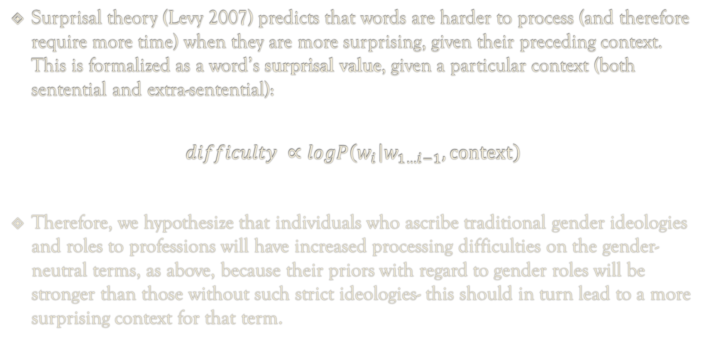
Hypothesis
Surprisal theory (Levy 2007) predicts that words are harder to process (and therefore require more time) when they are more surprising, given their preceding context. This is formalized as a word’s surprisal value, given a particular context (both sentential and extra-sentential):
$$difficulty ∝logP\left(w_{i} | w_{1…i−1},\text{context}\right)$$
Therefore, we hypothesize that individuals who ascribe traditional gender ideologies and roles to professions will have increased processing difficulties on the gender-neutral terms, as above, because their priors with regard to gender roles will be stronger than those without such strict ideologies- this should in turn lead to a more surprising context for that term.

Slide 6
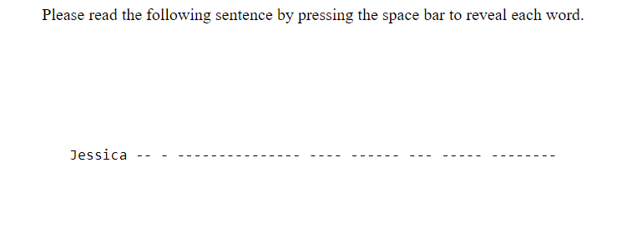
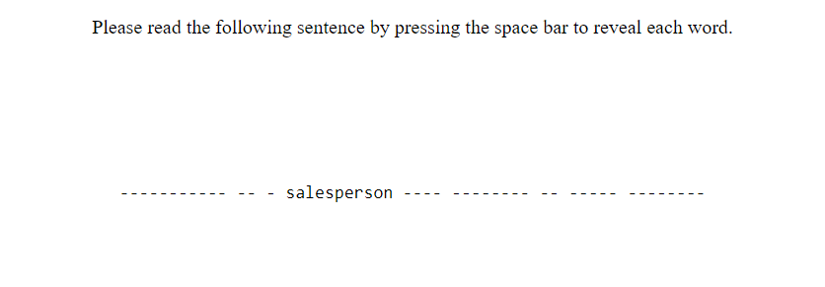
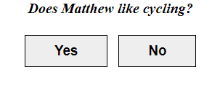
Methodology
39 titles normed for gender preference (107 forms)
20 titles tested in experiment (54 titles)
Self-paced reading task with four conditions:
Male name + male title
Male name + neutral title
Female name + female title
Female name + neutral title
Attention check questions unrelated to gender
Social Role Questionnaire (Baber & Tucker 2006)

Slide 7
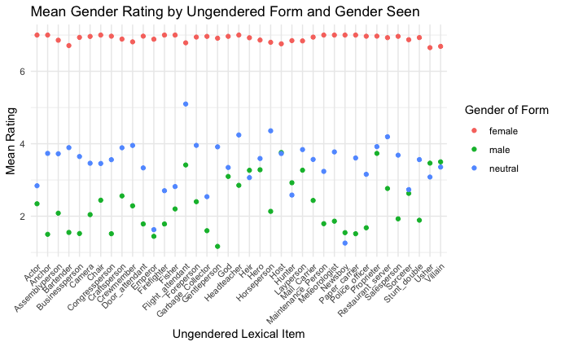
Preliminary Results: Norming

Slide 8
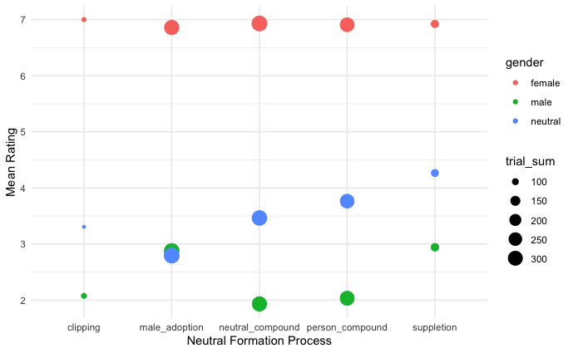
Preliminary Results: Norming

Slide 9
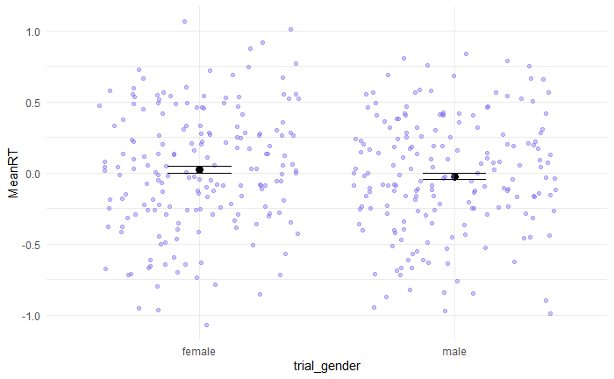
Preliminary Results: Experiment 1

Slide 10
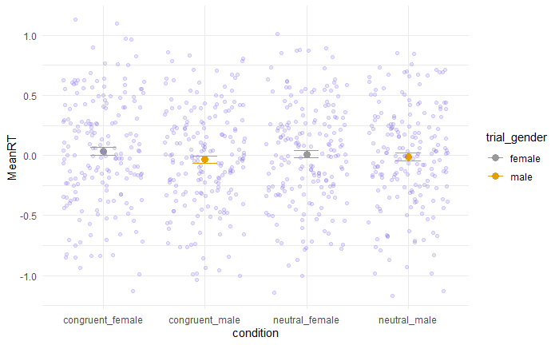
Preliminary Results: Experiment 1

Slide 11
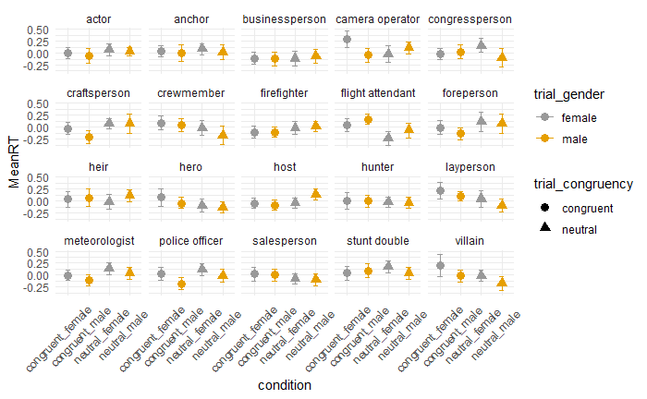
Preliminary Results: Experiment 1

Slide 12
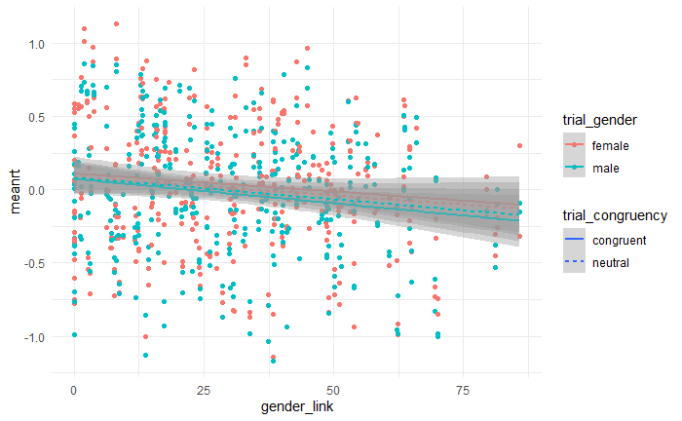
Preliminary Results: Experiment 1

Slide 13
Next Steps & Future Directions
Next Steps:
Getting frequency and/or modelled surprisal ratings for each of the terms in context
Please do not ask me about this, I will cry
Re-running mixed-effects models with frequency/surprisal ratings
Future Experiments:
Running a production study: “David is a congress___ from Pennsylvania”
Running a second perception study, using the A-MAZE paradigm (Forster et al 2009, Boyce et al 2020)

Slide 14
Thank you!
With special shout outs to my cohort (Adolfo, Alexia, Sarang, and Tony) – y’all have literally kept me sane this year
Thanks to Rob & Judith for managing my QP (and also me)
Thanks to Brandon, Leyla, Morgan, and Eva for help with experimental and theoretical help & consultations!

Slide 15
References
Baber, K. M., & Tucker, C. J. (2006). The social roles questionnaire: A new approach to measuring attitudes toward gender. Sex Roles, 54(7-8), 459-467.
Boyce, V., Futrell, R., & Levy, R. P. (2020). Maze Made Easy: Better and easier measurement of incremental processing difficulty. Journal of Memory and Language, 111, 104082.
Forster, K. I., Guerrera, C., & Elliot, L. (2009). The maze task: Measuring forced incremental sentence processing time. Behavior research methods, 41(1), 163-171.
Hilton, K. (2021). Gender Bias in Language Perception.
Levy, R. (2008). Expectation-based syntactic comprehension. Cognition, 106(3), 1126-1177.
Lev-Ari, S. (2015). Comprehending non-native speakers: Theory and evidence for adjustment in manner of processing, Front. Psychol. 5, 1–12.
von der Malsburg, T., Poppels, T., & Levy, R. P. (2020). Implicit gender bias in linguistic descriptions for expected events: The Cases of the 2016 United States and 2017 United Kingdom elections. Psychological science, 31(2), 115-128.
Schertz, J., & Hawthorne, K. (2018). The effect of sentential context on phonetic categorization is modulated by talker accent and exposure. The Journal of the Acoustical Society of America, 143(3), EL231-EL236.

